Slide 1
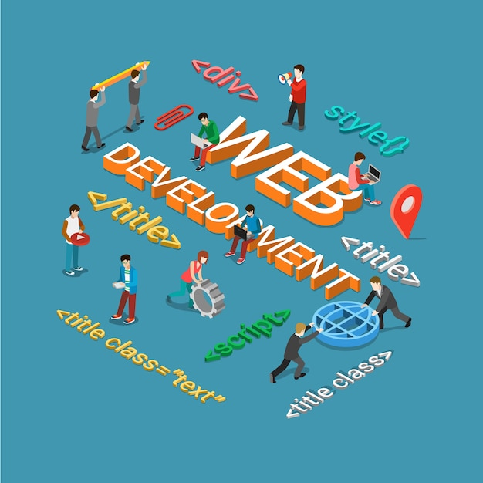
WEB DEVELOPMENT
TASK-1(20-03-2024)
Presented by
DUDDU ABHITHA
Web development encompasses all the tasks involved in creating and maintaining websites or web applications. It involves several disciplines, including:
Front-end Development: This focuses on the parts of a website that users interact with directly. Front-end developers use languages like HTML (Hypertext Markup Language), CSS (Cascading Style Sheets), and JavaScript to design and implement the user interface and user experience.
Back-end Development: This involves the server-side of web development, dealing with the logic and database interactions that power the website. Back-end developers use languages like Python, PHP, Ruby, Java, and frameworks like Django, Flask, Laravel, Spring, etc., to build the server-side functionality.

Slide 2
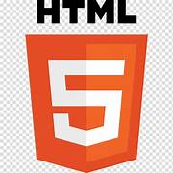
FRONT-END TECHNOLOGIES:
Front-end technologies are the tools and frameworks used to build the user interface and experience of a website or web application. Here are some commonly used front-end technologies:
HTML:
1.HTML stands for Hyper Text Markup Language
2.It is used to create single web page and multiple web pages
3.The current version of HTML is HTML5
4.The extension of HMTL is .html or .htm
5. HTML provides a way to structure content on a
web page using elements like headings, paragraphs, lists, images, links, and more.
6. HTML documents are written using plain text, and they consist of a series of HTML elements enclosed in angle brackets (< >), known as tags.

Slide 3
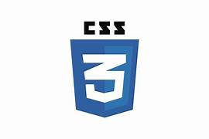
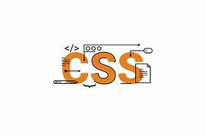
CSS:
1.CSS Stands for Cascading Style Sheets
2. It is a style sheet language used to define the presentation and layout of HTML documents.
3. CSS is used to control the appearance of HTML elements on a web page, including colors, fonts, spacing, layout, and more.
4. CSS enables the separation of content (HTML) from presentation (styling), allowing developers to apply consistent styles across multiple pages and easily update the look and feel of a website.
5. CSS selectors allow developers to target specific HTML elements based on their type, class, ID, attributes, and relationships with other elements.
6.Types of CSS:
Inline CSS
Internal CSS
External CSS

Slide 4
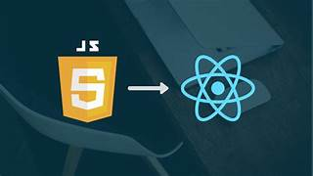
JAVA SCRIPT:
1.JavaScript is a programming language that adds interactivity and dynamic behavior to websites. Think of it as the language that makes web pages come alive.
2.JavaScript works closely with HTML and CSS, the other two core technologies of web development. It is used to manipulate HTML elements and apply styles defined in CSS.
3. JavaScript to create animations and special effects on web page.
4. JavaScript allows you to make web pages interactive.
5. JavaScript allows you to respond to events that occur on your web page, such as when a user clicks a button or moves their mouse. You can write code to perform actions when these events happens.
6.We can create functionality by using Java script.
7.Using React library to make more dynamic in the website.

Slide 5
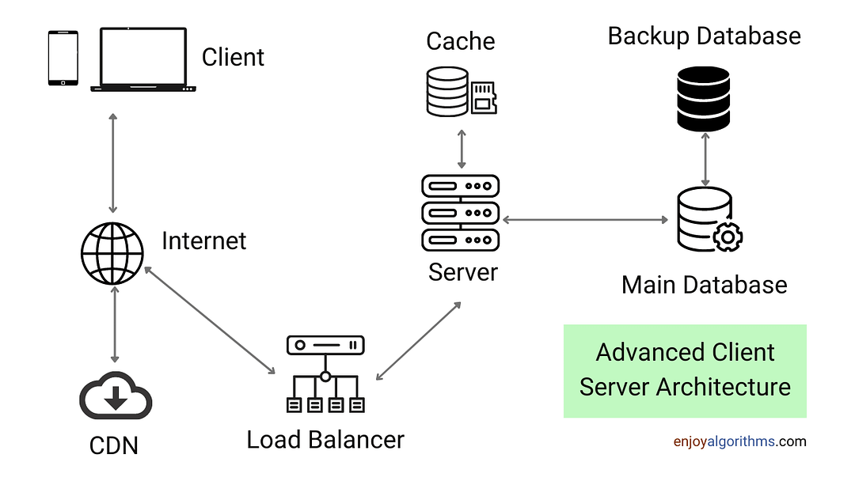
CLIENT-SERVER MODEL

Slide 6
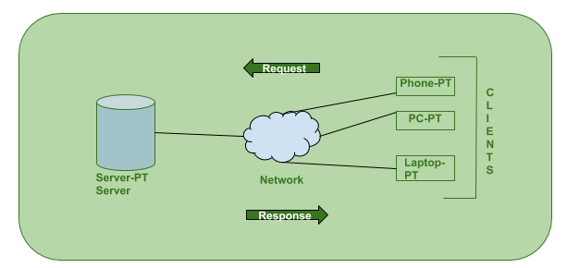
How the Client-Server Model works ?
In this article we are going to take a dive into the Client-Server model and have a look at how the Internet works via, web browsers. This article will help us in having a solid foundation of the WEB and help in working with WEB technologies with ease.
Client: When we talk the word Client, it mean to talk of a person or an organization using a particular service. Similarly in the digital world a Client is a computer (Host) i.e. capable of receiving information or using a particular service from the service providers (Servers).
Servers: Similarly, when we talk the word Servers, It mean a person or medium that serves something. Similarly in this digital world a Server is a remote computer which provides information (data) or access to particular services.

Slide 7
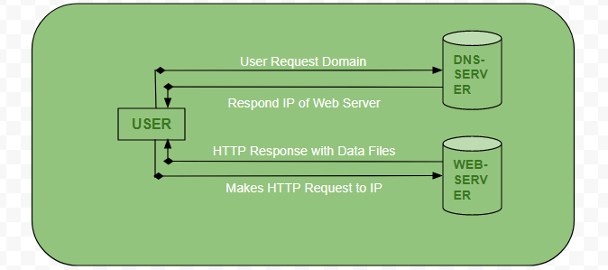
How the browser interacts with the servers ?
There are few steps to follow to interacts with the servers a client.
User enters the URL(Uniform Resource Locator) of the website or file. The Browser then requests the DNS(DOMAIN NAME SYSTEM) Server.
DNS Server lookup for the address of the WEB Server.
DNS Server responds with the IP address of the WEB Server.
Browser sends over an HTTP/HTTPS request to WEB Server’s IP (provided by DNS server).
Server sends over the necessary files of the website.
Browser then renders the files and the website is displayed. This rendering is done with the help of DOM (Document Object Model) interpreter, CSS interpreter and JS Engine collectively known as the JIT or (Just in Time) Compilers.

Slide 8
Difference between Framework and Library:
S.No | Framework | Library
1. | It comprises of lot of APIs , compilers , support programs , libraries etc. | It is a collection of helper modules , classes , objects , functions , pre-written code , etc.
2. | It is difficult to replace frameworks. | A library is easy to be replaced with another library.
3. | A framework development requires a lot of code that decrease performance and increase the load time. | Building a library requires less code , so there is better performance and fast load time.
4. | Including framework smoothly into an existing project is impossible. | Libraries can be integrated easily into existing projects to add some specific functionality.
5. | Its example are AngularJS , Spring , NodeJS , etc. | Its example are JQuery , React JS , etc.

Slide 9


